Slide 1

Constructing Parsing Tree – LR Parsing
Sabrina Tarin Chowdhury

Slide 2
LR Parsing
Bottom-up parser
LR parser reads their input from left to right
Produces a right-most derivation
It is called a Bottom-up parser because it attempts to reduce the top-level grammar productions by building up from the leaves

Slide 3
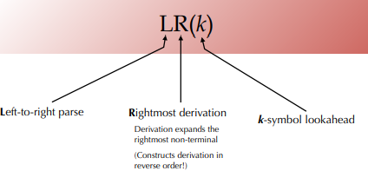
LR(k) Parser
L refers to the left-to-right scanning
R refers to the rightmost derivation in reverse
k refers to the number of unconsumed “look ahead” input symbols that are used in making parser decisions.

Slide 4
LR Parser Algorithm
LR Parsing algorithm is the same for all the parser, but the parsing table is different for each parser. It consists following components as follows.
Input Buffer It contains the given string, and it ends with a $ symbol.
Stack The combination of state symbol and current input symbol is used to refer to the parsing table in order to take the parsing decisions.

Slide 5
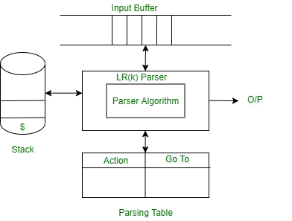
Parsing Table
Parsing table is divided into two parts- Action table and Go-To table. The action table gives a grammar rule to implement the given current state and current terminal in the input stream. There are four cases used in action table as shown in next slide.

Slide 6
Parsing Table
shift: push the current input symbol onto the stack, and go on to the next input symbol (i.e., call the scanner again)
reduce: a grammar rule's right-hand side is on the top of the stack! pop it off and push the grammar rule's left-hand-side nonterminal
accept: accept the input (parsing has finished successfully)
reject: the input is not syntactically correct

Slide 7
Work Flow
The stack is empty, and we are looking to reduce the rule by S→$$.
Using a “.” in the rule represents how many of the rules are already on the stack.
A dotted item, or simply, the item is a production rule with a dot indicating how much RHS has so far been recognized.

Slide 8
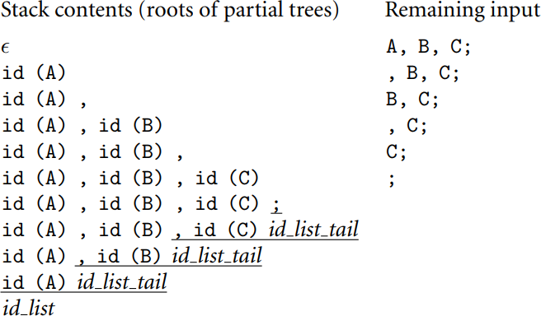
LR Parsing
Rightmost (canonical) derivation for the identifiers grammar:
id_list → id id_list_tail id_list_tail → , id id_list_tail
id_list_tail → ;

Slide 9
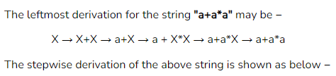
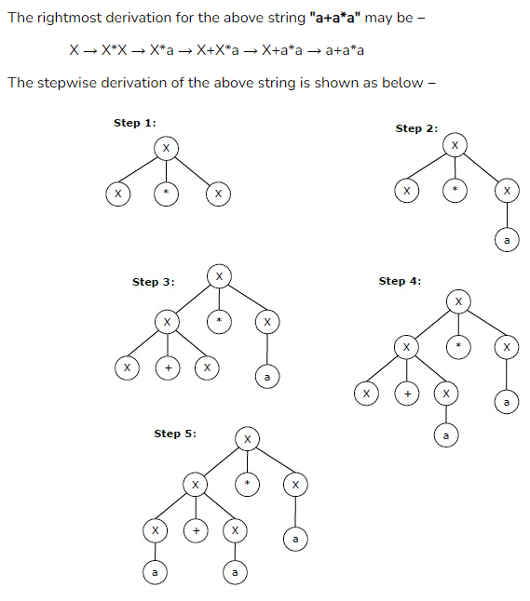
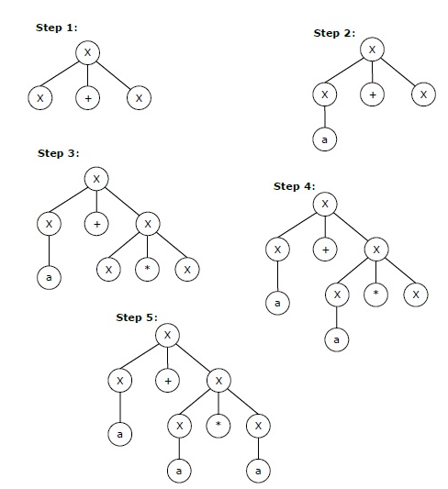
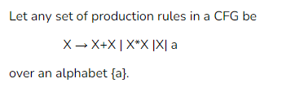
Difference Between LL and LR

Slide 10
Advantage over LL
LR parsers can parse a strictly larger class of grammars than (top-down) predictive parsers.
LR parsers detect errors fast.

